Slide 1

Quick Reference Guide to eLTE Smart City Solution
Governance, public utilities, and industrial economies provide best opportunities for the Smart City solution.
Challenges for fast-growing cities
eLTE Smart City Solution, creating new city development mode
Traffic congestion
Environmental pollution
Public utilities
Governance
Industrial economies
City security
Energy shortage
Safer
Greener
Efficient
Wireless and IoT technologies make smart cities a reality.
Governance
Public utilities
Industrial economies
Smart applications
Safe city
City surveillance
Remote metering
Public services
Smart campus
Smart agriculture
…
Three
platforms
Service application enabling platform
Big data service support platform
ICT capability exposure platform
One
Cloud
Municipal Cloud DC
Two
networks
Wireless communications network
City IoT
eLTE
eLTE-L
eLTE-U
eLTE-IoT
eLTE-L
eLTE-U
eLTE-IoT
400 MHz/700 MHz/800 MHz/1.4 GHz/1.8 GHz/2.3 GHz
Voice trunking and group call delay: < 300 ms
Video dispatching with 20-channel concurrent videos per cell
2.4 GHz/5.8 GHz
2-3x Wi-Fi coverage
E2E delay: < 50 ms
Super backhaul capability: 20 Mbit/s@35 km
470-510/863-870/902-928 MHz
Maximum coverage: 10 km; basement level: 2
High-density connection: 10,000 connections per cell
Ultra-low power consumption with a maximum battery service life of 10 years for vehicle detectors of 10 years
ISM Band: 470-510/863-870/902-928 MHz

Slide 2

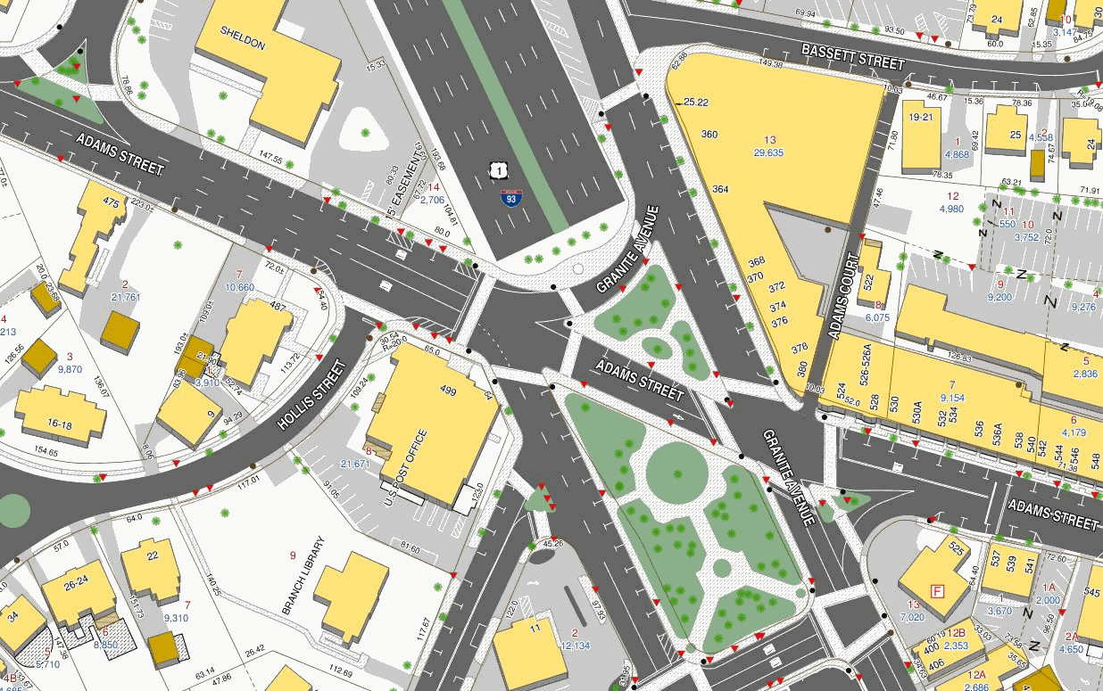






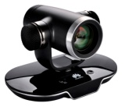
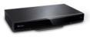

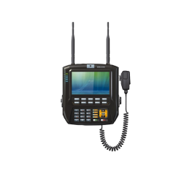
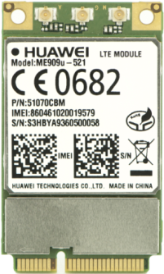
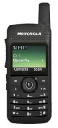
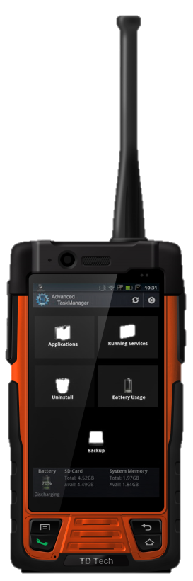

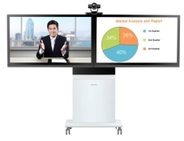
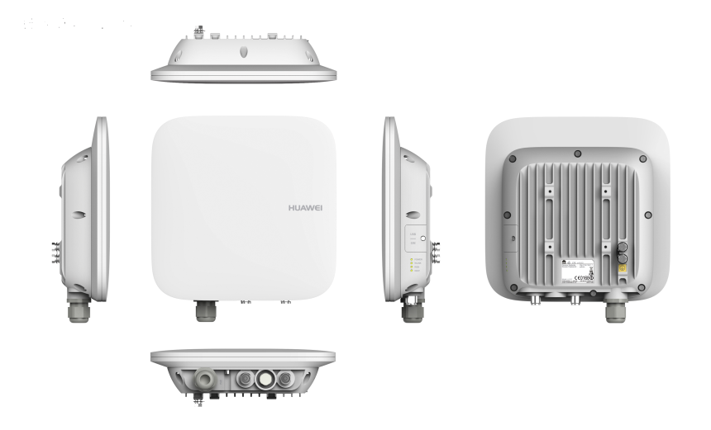


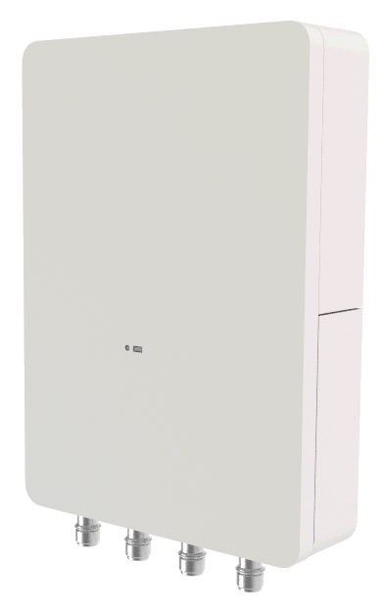

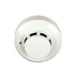

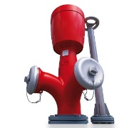
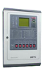
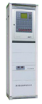
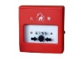
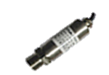
Smart City Solution Scenarios – Safer
Convergent command, visualized city management
Self-developed
Cooperation
Command center
Customer pain points
Department information is isolated and cannot be shared or managed.
On-site information is invisible and the response speed is slow, making it hard to give command in real time.
There are large surveillance areas in the city and scenarios are complex, making it hard to cover all expected surveillance areas.
Customer benefits
Information resources are integrated and shared. Government administration efficiency is improved by 50%.
The public satisfaction rate improves by 40% through real-time video backhaul, transparent law enforcement process, and whole-process monitoring.
The eLTE-U adopts the compact and light design, supports Dual 100 MHz cells and 36-channel HD video access, and does not require licensed spectrums.
The 4-in-1 terminal enables voice, law enforcement, video, and office functions.
Maturity: global commercial use; Cases: Ghana, Spain, Nanjing, Shanghai, and Wujiang
GIS platform
(SuperMap, ArcGIS)
CAD platform
(Hexagon and DS)
eSDK
PWI – integrated information platform
Wireless cameras integrated with the eLTE-U module
Telephone/SMS/Email/App
/Social media
Tetra narrowband trunking
eLTE broadband trunking
Mobile law enforcement terminal
Law enforcement recorder
Traditional network cameras connected to the DAU
Conference terminal
eLTE-U video backhaul
IoT-based monitoring for intelligent fire extinguishing and public fire safety
Self-developed
Cooperation
Customer pain points
Traditional fire alarm devices with cables are hard to install due to cabling difficulties.
Construction affects citizens' and tourists' daily lives, and shop operations.
Fire alarms and fire-fighting facilities status are related to life and property security. Public bearer networks, however, cannot ensure network quality and communication security.
Customer benefits
Devices are easy to install with no cables. The total cost of ownership (TCO) decreases by 20%.
Devices start to work upon being installed. The construction period is under control. It takes only five minutes to complete deployment in a shop.
Dedicated eLTE-IoT emergency network prevents public network congestion and transmission faults affecting fire alarm emergency processing.
Maturity: in pilot in China (Luohe fire fighting)
China Electronics Technology Group Corporation No. 38 Research Institute
Yunfan Technology
Push fire alarms to enterprise managers
Fire alarm system
Push fire alarms to fire alarm departments
Fire alarm, fault, and violation event reporting
eLTE-IoT
ISM band
China Electronics Technology Group Corporation No. 38 Research Institute
Yunfan Technology
Automatic fire alarm reporting
Fire extinguishing pipe pressure monitoring
Fire hydrant status reporting

Slide 3
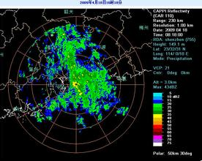
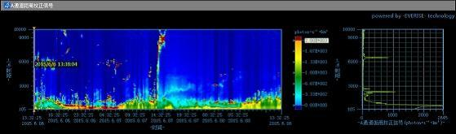
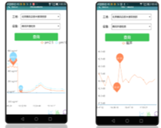
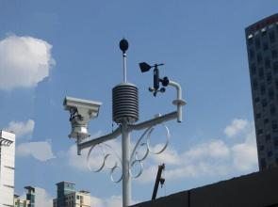
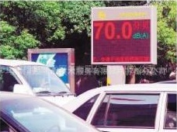
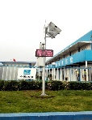
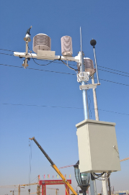
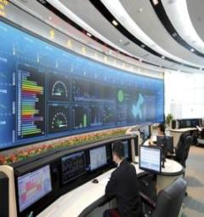
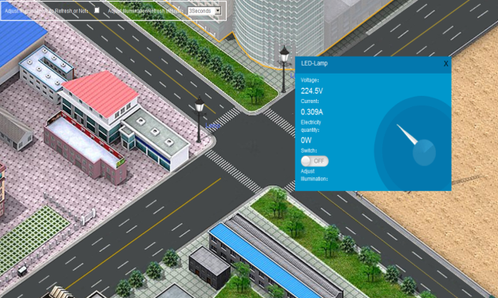


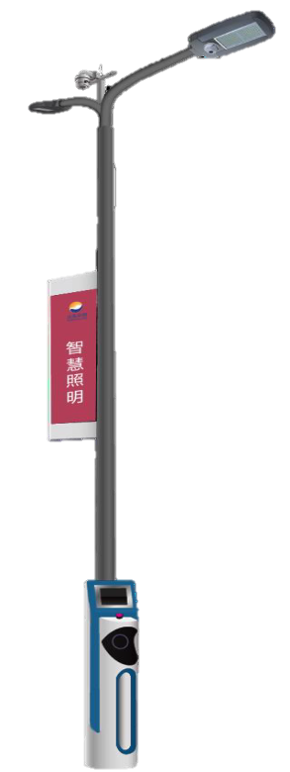

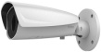
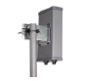
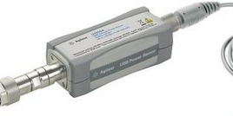
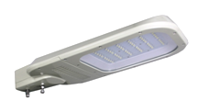
Smart City Solution Scenarios – Greener
City environment monitoring and IoT information is displayed.
Self-developed
Cooperation
LHZW
Customer pain points
Diverse terminals are used, resulting in co-existence of multiple vendors and networks. This makes O&M difficult. Customers are willing to improve networking.
The existing RFID/ZigBee/Wi-Fi solution has small coverage and involves multiple nodes. Connection reliability is affected by the environment. Services can hardly be expanded.
Customer benefits
A maximum of 10-km area is covered. The number of network nodes to be deployed decreases by 90%.
The flattened network is easy to operate and maintain. The number of mesh network nodes and maintenance workload decrease. The TCO decreases by 20% in total.
The network is easy to deploy. The IoT module is open and easy to integrate, which allows it to be adapted to diverse terminals.
One network provides multiple services and new services can be flexibly expanded.
Maturity: in pilot in China (Tongzhou in Beijing)
Meteorological monitoring
Municipal DC
Noise monitoring
Pushing dust raising/PM2.5 information
eLTE-IoT
ISM band
LHZW
Meteorological data collection
Noise monitoring
Dust raising and pollution monitoring
eLTE enables a new management mode of intelligent street lamps.
Self-developed
Cooperation
Customer pain points
Energy bills increase sharply. 30-50% of public mains is used for street lighting.
Maintenance costs are high and faults are difficult to locate.
The ZigBee mode cannot carry large-scale networking and multi-hop transmission delay is uncontrollable. The PLC mode is interfered by line impedance changes, resulting in poor communication reliability.
Customer benefits
Single-lamp lighting is controlled with one hop, effectively saving energy by 30%.
Policies and parameters are remotely set. Faults are automatically reported. No maintenance costs are incurred.
The TCO in the non-cable mode is 50% lower than that in the cable mode.
Broadband and narrowband services are integrated. Lamp-post address resources are fully utilized to provide value-added services, improving economic benefits.
Maturity: in pilot in China
AOD
Lighting control
Visualized management
Value-added services, such as video and advertisement delivery
eLTE-IoT
ISM band
eLTE-U
5.8 GHz
Video surveillance
Built-in eLTE-U communication module of the camera
Remote lighting control
Built-in eLTE-IoT module of the street lamp controller
Non-hotspot areas
Hotspot areas
Electronic advertising screen
Advertisement placement
Information release
Wi-Fi hotspot
Wi-Fi hotspots provided by the eLTE-U
AOD
Streetlight controller
Charging station
Electric vehicle
Electric bicycle

Slide 4
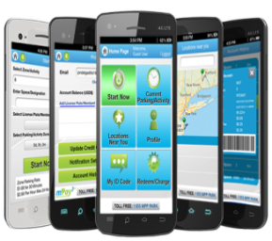
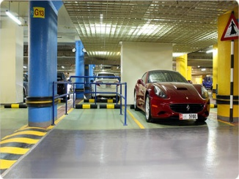
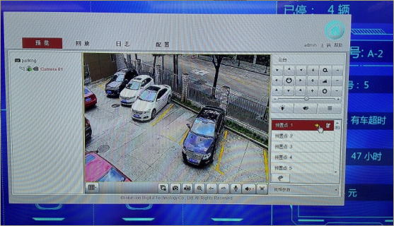
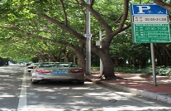
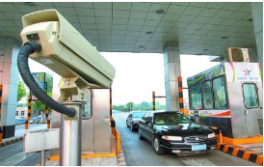

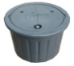

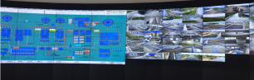
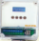
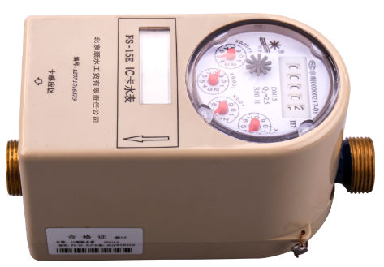
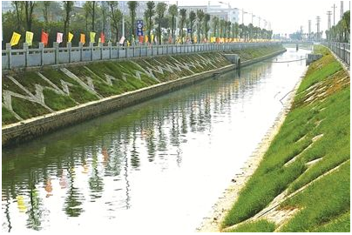
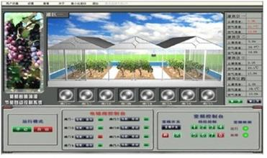

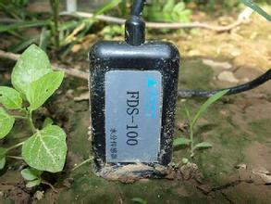
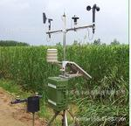
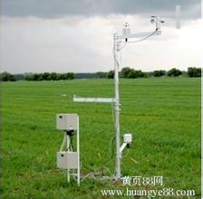

Smart City Solution Scenarios – Efficient
Intelligent parking, effectively managing outdoor (curb and open campus) parking lot
Self-developed
Cooperation
Customer pain points
Unbalanced outdoor parking usage and turnover cause traffic congestion and illegal parking.
The existing ZigBee RF mesh network is vulnerable to interference and less stable with small areas covered by the gateway. The network cannot be deployed on the open road.
Customer benefits
Coverage capability increases by 10 times than that of the ZigBee RF mesh network. The new solution can be easily deployed with fewer convergence gateways involved. The TCO reduces by 20% in total.
Parking lot utilization increases by 40% and the illegal parking ratio decreases by 90%.
Ultra-low power consumption ensures a maximum battery life of five years for vehicle detectors.
Maturity: in pilot in China
Parking lot reservation and navigation
License plate recognition and electronic payment
Fangle
eLTE-IoT
ISM band
eLTE-U
5.8 GHz
Fangle
Outdoor parking
Vehicle detector
eLTE-U video backhaul
Vehicle license plate recognition
Smart Water, enabling remote meter reading and dynamic river hydrological monitoring
Self-developed
Cooperation
Customer pain points
Missing report rate of existing meters is greater than 15%, which needs to be corrected through manual efforts. Management difficulties and costs increase.
Power consumption of the traditional GPRS solution is large. The battery service life is one to three years so that batteries need to be replaced regularly.
Customer benefits
Missing report rate of existing meters is less than 0.5%. O&M costs are reduced and revenues of water companies increase.
Ultra-low power consumption ensures that the battery service life reaches 10 years and the battery does not need to be replaced during the battery lifecycle.
The water quality is monitored dynamically to ensure water supply security.
Maturity: in pilot globally; FOA: ADM in Mexico and EPAL in Angola
Jiangxi Sanchuan Water Meter Co., Ltd.
AUGUR
Intelligent remote meter reading system
Dynamic hydrology monitoring and river video surveillance
eLTE-IoT
ISM band
eLTE-U
5.8 GHz
Watermark data reporting
Water quality data reporting
eLTE-U video backhaul
Jiangxi Sanchuan Water Meter Co., Ltd.
AUGUR
Automatic household meter reading
River hydrology monitoring
Smart agriculture
Self-developed
Cooperation
Shandong Futong
Customer pain points
In the modern agriculture, big data, rather than individual experience, should be used to obtain accurate information in real time and make decisions.
Wired sensors are deployed to collect data, which incurs high costs, and are difficult to maintain.
Customer benefits
Wireless data collection devices are used. The devices are portable and easy to store. The devices can be installed in shelters and greenhouses in any condition.
Precise farming and complete information collected by the IoT help make scientific decisions and improve the production.
Maturity: in pilot in China
Shelter environment monitoring
Planting area video surveillance
eLTE-IoT
ISM band
eLTE-U
5.8 GHz
Shandong Futong
Soil temperature and humidity sensor
Acoustic-optic sensor
Air temperature and humidity sensor
Video surveillance

